Slide 1
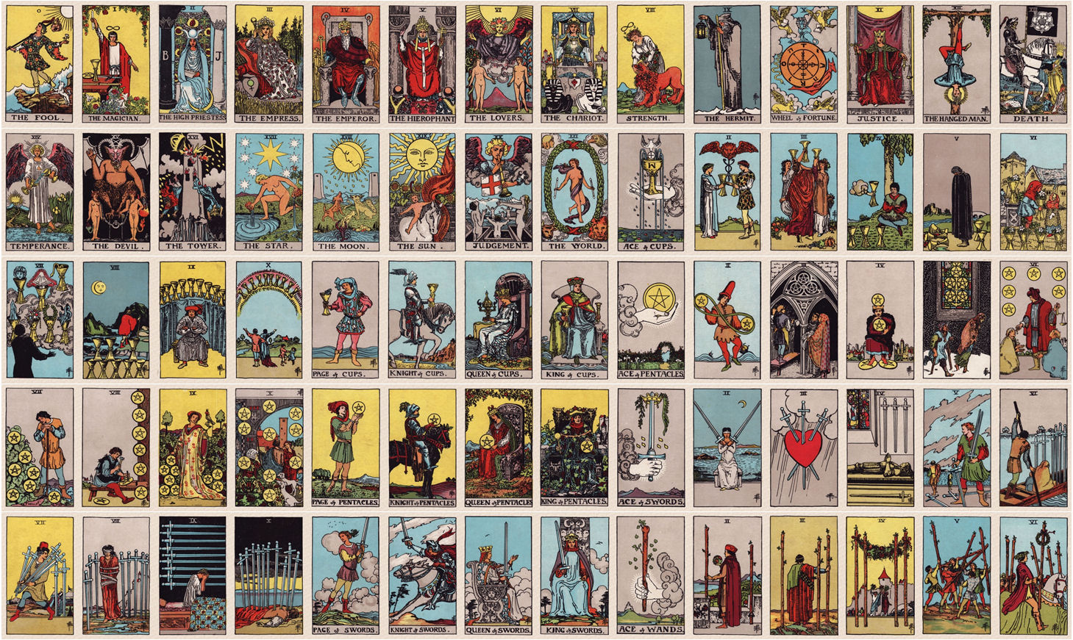
MASTERS OF THE TAROT | 2019
MASTERS OF THE TAROT | 2019
T H E A K A S H A & T H E T A R O T
T H E A K A S H A & T H E T A R O T
Notes:
Q: What are the Akashic Records?
Q: Are there any special requisites before gaining access?
Q: What are its origins?
- Origins of Akasha from Eastern perspective
- Tarot is a microcosm symbolic of the Akashic macrocosm
- Beginner’s advantage: objects on table in between two; picking objects to try to communicate with each other
- Seasoned readers: technique for reading with an unfamiliar deck: use your access to the Akashic Records

Slide 2
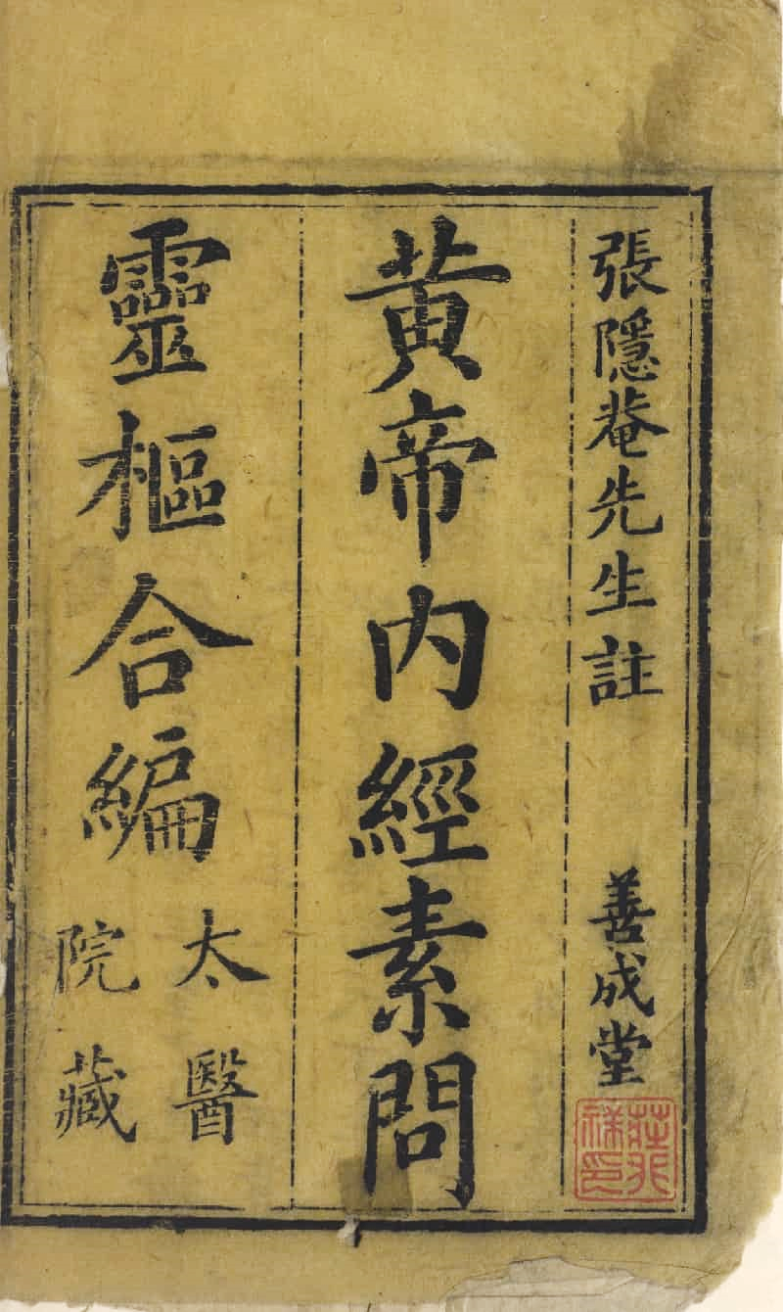
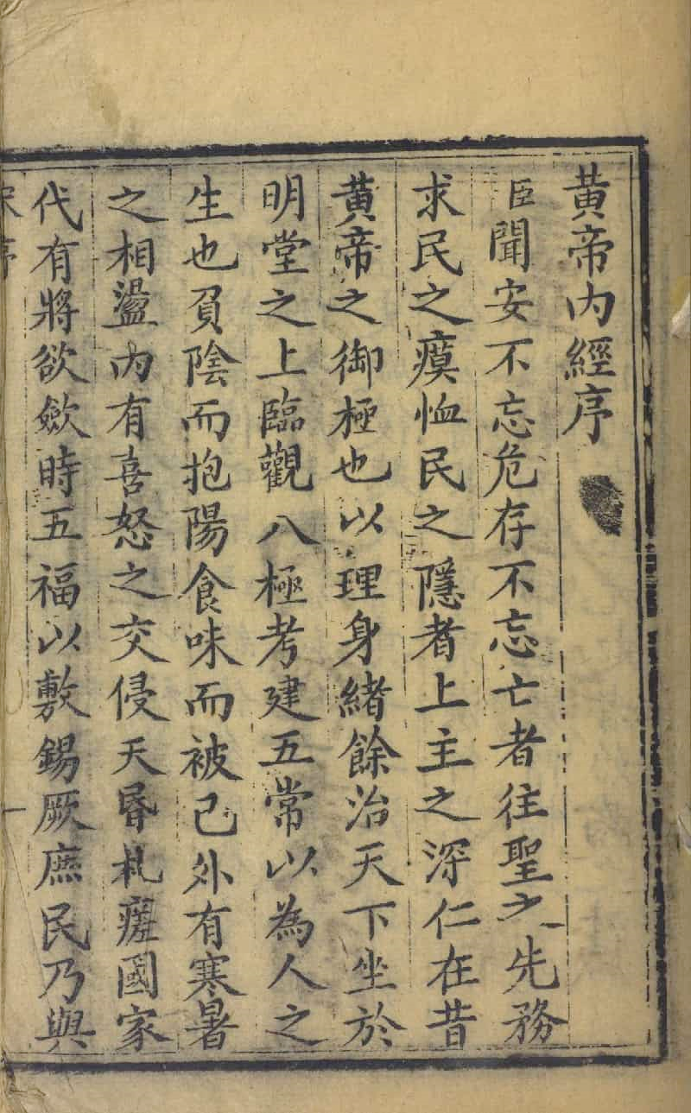
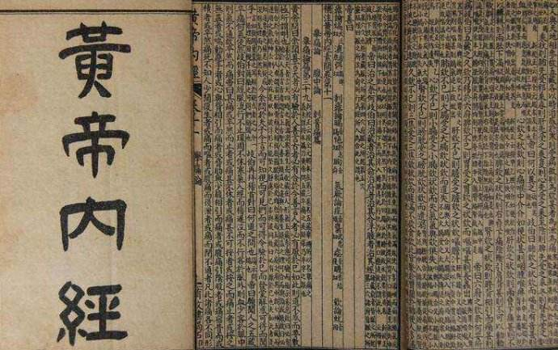
MASTERS OF THE TAROT | 2019
  Inner Canons of the Yellow Emperor
  Book I: Basic Questions (400 BC)
  Book II: Spiritual Pivot (200 BC)
T H E A K A S H A & T H E T A R O T
Notes:
One of the earliest sources we can document references to the Akashic Records: Huangdi Neijing
Book I: Basic Questions, 400 BC | Book II: Spiritual Pivot, 200 BC
Written in Socratic dialogue format between the Yellow Emperor as a child and the ascended masters
Note: Not about implementing Asian into Western. This is about reducing both to a common denominator to reveal a core, universal truth

Slide 3




MASTERS OF THE TAROT | 2019
  The young emperor asks the sage:
What is
神
?
Shen
神
God(s)
Spirit(s)
Consciousness
Shen
T H E A K A S H A & T H E T A R O T
Notes:
Example of passage from the text with Akashic Records reference: Socratic Dialogue
Emperor: What is God/Consciousness?
The Ascended Masters then answer…
Significance of etymology; grammar reveals cultural ideologies
Singular vs. plural context

Slide 4
MASTERS OF THE TAROT | 2019
Inner Canons of the Yellow Emperor, 400 BC – 200 BC
  The ascended master answers:
“Please speak the name of
神.
神
is the Akasha.”
虛空
Invocation
The Word is the Key
T H E A K A S H A & T H E T A R O T
Notes:
Q: How do you access the Akashic Records? = Q: Who/What is God/Spirit/Divinity/Consciousness?
1. By speaking the Word.

Slide 5
MASTERS OF THE TAROT | 2019
Inner Canons of the Yellow Emperor, 400 BC – 200 BC
“Akasha is the ears that do not need to hear or listen to know.”
Clairaudience
Claircognizance
Form of channeling
T H E A K A S H A & T H E T A R O T
Notes:
Q: How do you access the Akashic Records? = Q: Who/What is God/Spirit/Divinity/Consciousness?
1. By speaking the Word.
2. By using your psychic senses, not physical senses.

Slide 6
MASTERS OF THE TAROT | 2019
Inner Canons of the Yellow Emperor, 400 BC – 200 BC
“Akasha is knowledge that cannot be heard.”
Clairvoyance
Clairsentience
T H E A K A S H A & T H E T A R O T
Notes:
The four clairs are addressed as tools of access.

Slide 7
MASTERS OF THE TAROT | 2019
Inner Canons of the Yellow Emperor, 400 BC – 200 BC
“Akasha’s eyes are clear.”
“Akasha is when
the heart is open and
the mind is put first.”
Impartial
Observer
Compassionate
Rational
T H E A K A S H A & T H E T A R O T
Notes:
Q: How do you access the Akashic Records? = Q: Who/What is God/Spirit/Divinity/Consciousness?
1. By speaking the Word.
2. By using your psychic senses, not physical senses.
3. By being an impartial observer.
4. By being compassionate.
5. By being rational.

Slide 8
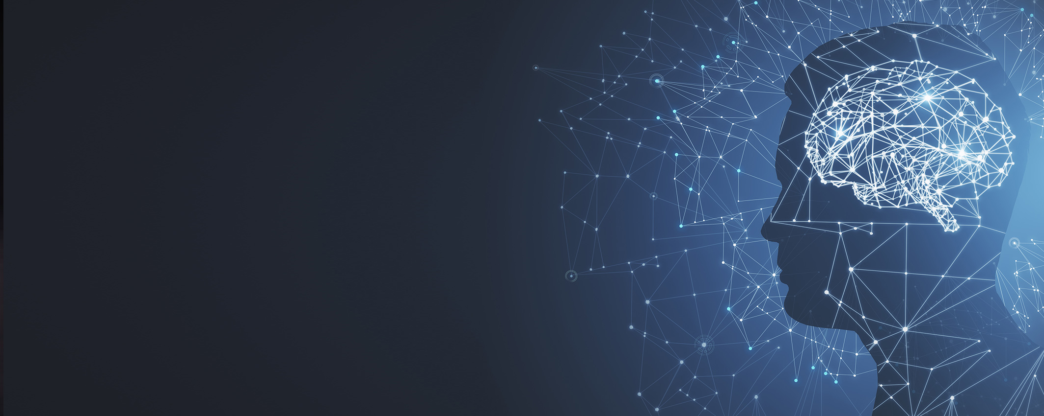

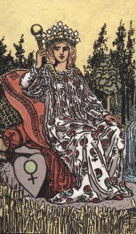

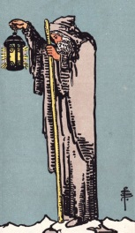
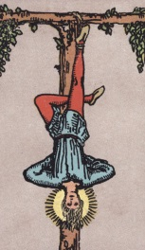

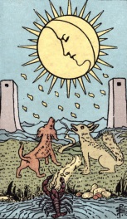
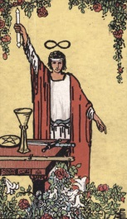
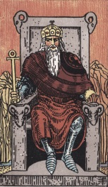
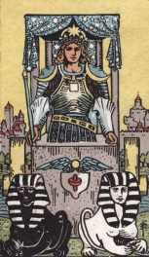
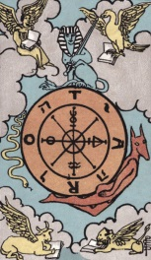
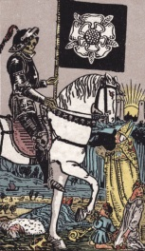
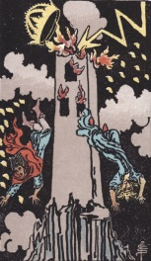

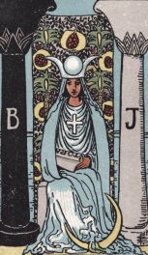
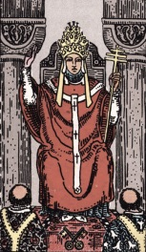

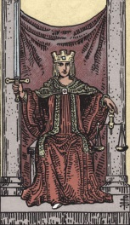
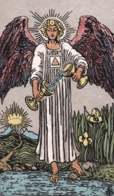


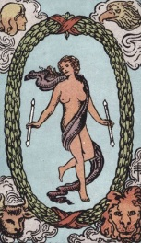
MASTERS OF THE TAROT | 2019
Shen = Akasha = Psychic Connection to the Universe [through the Mind]
神
神
神
神
神
神
神
神
神
神
神
神
神
神
神
神
神
神
神
神
神
神
神
The Tarot Keys Unlock the Gates of Access to the Mind = Akasha = Shen
T H E A K A S H A & T H E T A R O T
Notes:
Q: How do you access the Akashic Records? = Q: Who/What is God/Spirit/Divinity/Consciousness?
1. By speaking the Word.
2. By using your psychic senses, not physical senses.
3. By being an impartial observer.
4. By being compassionate.
5. By being rational.
Tarot is psychic technology, a tool that gains you access.

Slide 9

MASTERS OF THE TAROT | 2019
虛空藏
菩薩
xū kōng zàng pú sà
Ākāśa garbha
Bodhisattva
T H E A K A S H A & T H E T A R O T
Notes:
Another early text with references to the Akashic Records are some of the sutras of the Akashagarbha bodhisattva.
English transliteration/spelling: S becoming Sh

Slide 10
MASTERS OF THE TAROT | 2019
“When the Sun of Spirit has risen,
Awakening of a
higher consciousness
“a sentient being can be filled with the Light of
primordial wisdom…
Access to
the Akashic Records
The Akashagarba Sutra [before 400 AD]
T H E A K A S H A & T H E T A R O T
Notes:
[Copy referenced: sourced from Sanskrit to traditional Chinese translation circa Jin Dynasty– chemistry, alchemy, and medicine flourishing at this time.]
Q: How do you access the Akashic Records? = Q: Who/What is God/Spirit/Divinity/Consciousness?
1. By speaking the Word.
2. By using your psychic senses, not physical senses.
3. By being an impartial observer.
4. By being compassionate.
5. By being rational.
6. The more you awaken to a higher consciousness, the greater the access to the Akashic Records.

Slide 11
MASTERS OF THE TAROT | 2019
“…and actualize the inconceivable Spirit,
the Akasha.”
You speak for the Akasha.
Channeled messages.
The Akashagarba Sutra [before 400 AD]
T H E A K A S H A & T H E T A R O T
Notes:
Lines blur between individual sentience and divine consciousness

Slide 12
How to Access the Akashic Records
By speaking the Word - Invocation
Clairvoyance, clairaudience, clairsentience, etc.
By being an impartial observer
By being compassionate: empathic connection
By being rational: systematic correspondences
The more you awaken to a higher consciousness, the greater the access to the Akashic Records.
T H E A K A S H A & T H E T A R O T
Notes:
Don’t need to know this. We’re going to learn these six conditions through actual practicum.
At this time, turn to the half-sheet folded handouts.
[After overview of method, check time. If running over, end here and start the practic]

Slide 13
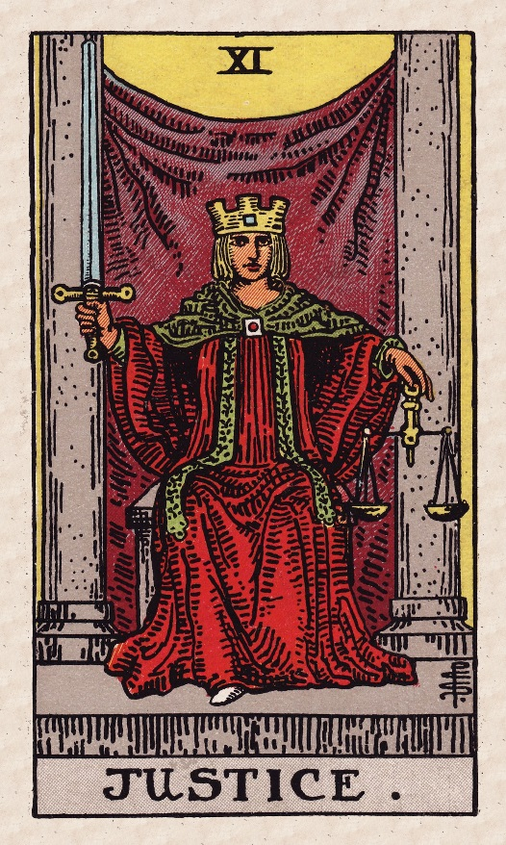
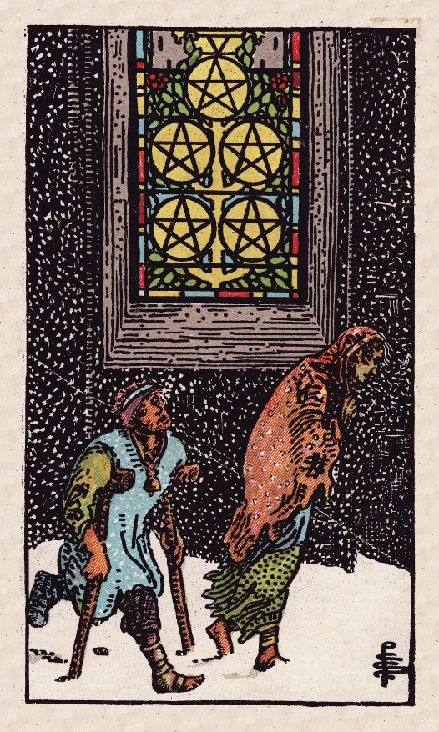
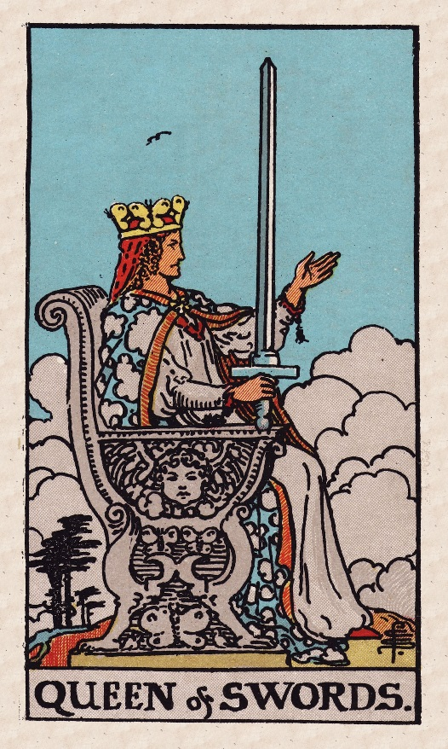
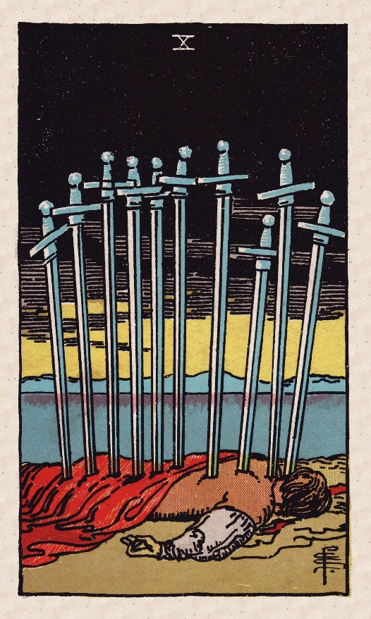
MASTERS OF THE TAROT | 2019
Spirit or Facet of Consciousness
1. Subject 2. Call to Action 3. Descriptive
T H E A K A S H A & T H E T A R O T
Notes:
Spirit Present: Justice Rx
Option to not read with reversals: simply turn the card over with intentionality; noticed this era one where general inclination is no reversals
Justice: wield Sword of Truth + balancing scales to adjudicate; archetype of The Judge: great listener, adhere to an internal code; may relate to current events; exercise reason and intellectualism
Three Cards:
Five of Pentacles, Ten of Swords Rx, Queen of Swords Rx
Option not to read with reversals:
Five of Pents: Material, sentient struggles; blocked from ascending to the upper registers on the Tree of Life; trapped in a cycle of poverty
Queen of Swords: Fierce, unapologetic independent discernment; “Also, I see butterflies…”
Ten of Swords: Damned if you do, but damned if you don’t. Archetype of the martyr.

Slide 14


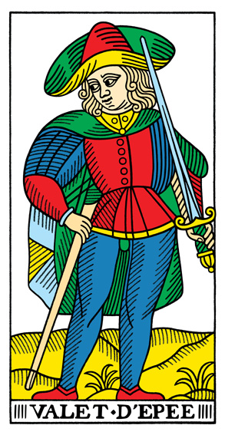

MASTERS OF THE TAROT | 2019
Spirit or Facet of Consciousness
1. Subject 2. Call to Action 3. Descriptive
T H E A K A S H A & T H E T A R O T
Notes:
TdM Nine of Wands:
Court de Gebelin: Prognosticates good fortune [Thoth: Strength];
Papus: Realization of success of an enterprise or creative undertaking; Mathers: Order, discipline, a gift
Six of Coins: Subject
Gift; overcoming past struggles with money matters; success in a financial endeavor
Page of Swords: Call to Action
Forces causing subject to be in transition; mindset of a soldier; prognosticating battle to come (victory predicted)
Seven of Swords: Descriptive
Papus: Assured success in a pending struggle; overcoming misfortune; defeating an adversary [Tarot of the Bohemians]

Slide 15
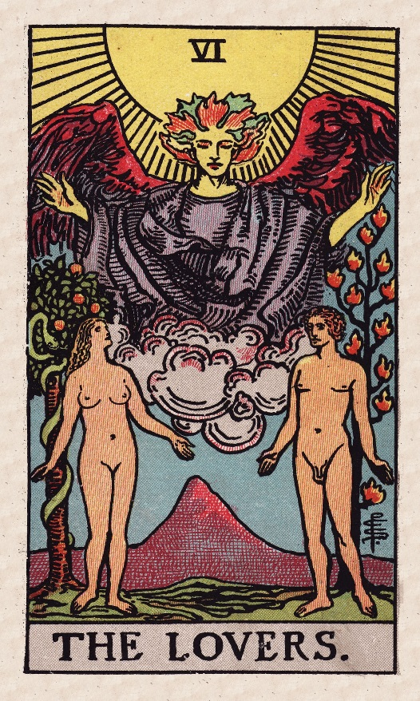
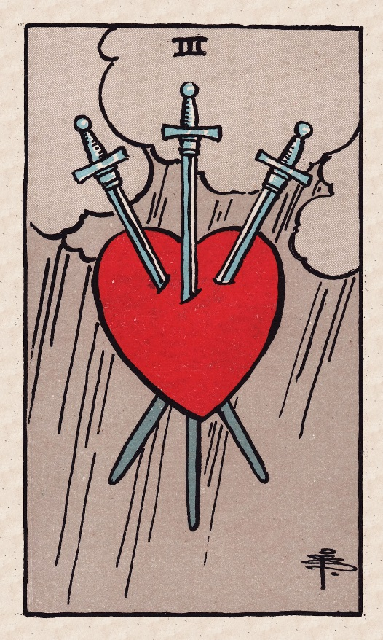
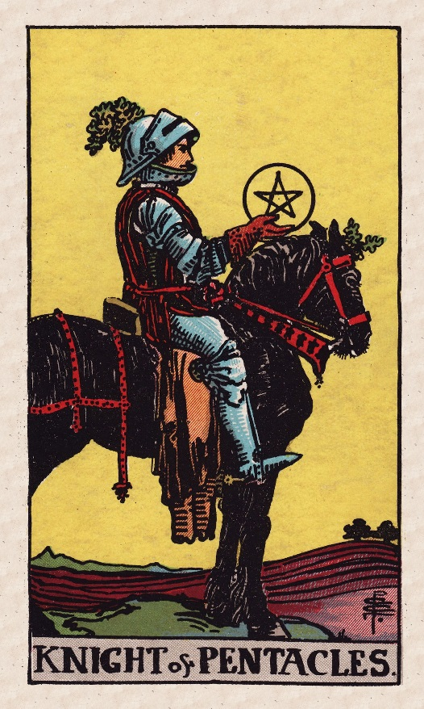
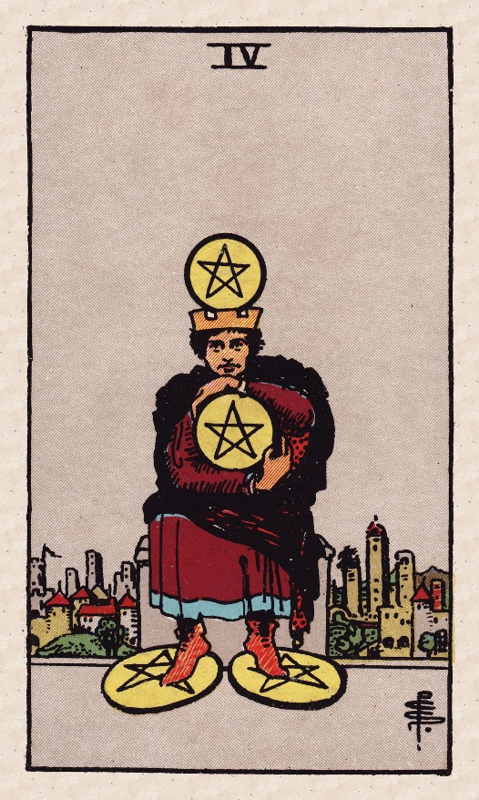
MASTERS OF THE TAROT | 2019
Spirit or Facet of Consciousness
1. Subject 2. Call to Action 3. Descriptive
T H E A K A S H A & T H E T A R O T
Notes:
Key 6: Lovers
How do you connect to the symbolism and implications here?
(a) Love, romance, marriage, relationship
(b) Difficult choice; moral quandary; one “right” one “wrong” but which is which
Higher voice of reason coming through
Three of Swords: Sadness, grief, ideological clash, emotional conflict; “truth piercing through an untrue heart” [Tonybee’s Positively Tarot]
Knight of Pentacles (note: facing Four of Pents): “Slow and steady wins the race” – Exercise care and caution
Four of Pentacles: Conserve, draw clear boundaries, do not sacrifice or waste your own resources and assets

Slide 16
MASTERS OF THE TAROT | 2019
By speaking the Word - Invocation
Clairvoyance, clairaudience, clairsentience, etc.
By being an impartial observer
By being compassionate: empathic connection
By being rational: systematic correspondences
The more you awaken to a higher consciousness, the greater the access to the Akashic Records.
T H E A K A S H A & T H E T A R O T

